Slide 1

Predicting customer buying behaviour
25/09/2023
- Amey Desai

Slide 2
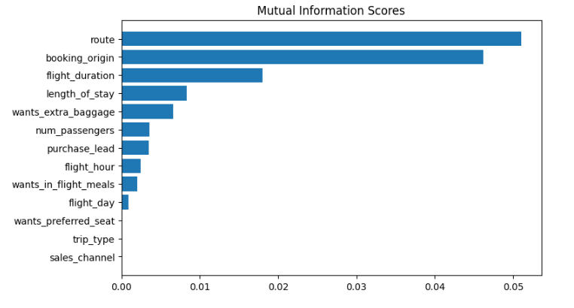
Predictive model to understand factors that influence buying behaviour
We have trained the data set with Random forest classifier model and received :-
ACCURACY:- 85.09
AUC score:- 0.56
Top 5 features which influence Customer buying behavior are :-
route
booking_origin
flight_duration
length_of_stay
wants_extra_baggage
We need to increase the AUC score.

